Slide 1
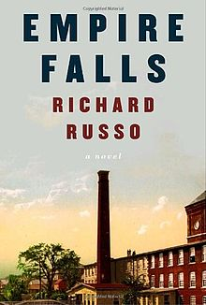
Richard Russo
The great storyteller of the rust belt
C.E. Sikkenga
English 10
Mr. Sikkenga
3rd, 5th and 6th Hours

Slide 2
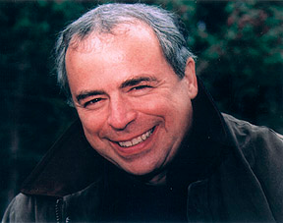
Who is Richard Russo?
Pulitzer Prize-winning author
Famous Works: Empire Falls, Nobody’s Fool.
Small town stories; fathers and sons
Known for humor, humanity, small moments.

Slide 3
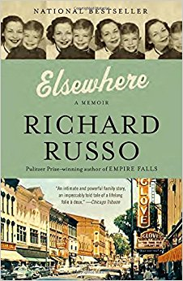
How Russo’s surroundings impact his work
Grew up in Gloversville, upstate NY
Saw economic downturn
Understands dying small towns
Later became English professor

Slide 4
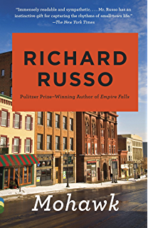
How Russo’s Background influences his work.
Father bailed when Russo was young
  Early novels deal with fathers/sons
Raised by mother in tough times
Later books drawn on work, aging

Slide 5
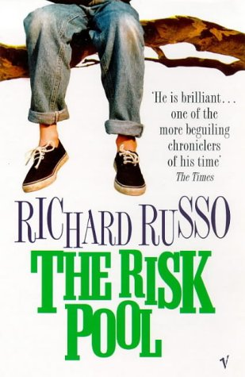
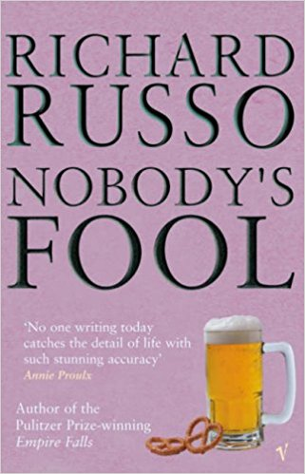
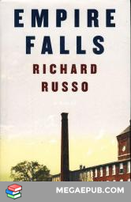
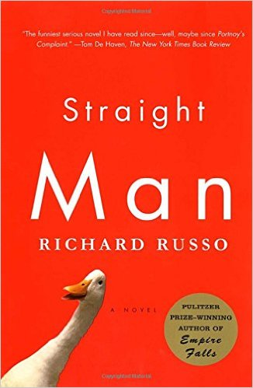
Some key Russo works

Slide 6
WHY IS RUSSO VALUED?
Seen as an “American Dickens”
Realism: “All of it is true…”
Warmth and humor.
Faith in humanity. Even screw ups.

Slide 7
Russo’s critics point out
His books are too long (but rarely boring)
Repeats himself
Genre/Pulp/Not “Serious” Lit.

Slide 8
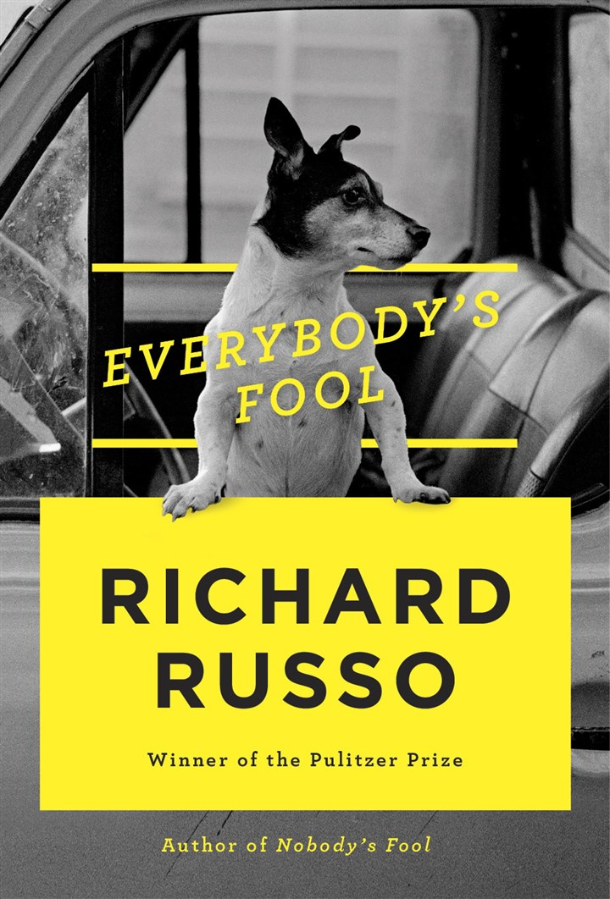
Russo remains popular
Many can relate to family themes
His characters feel real
Warmth, humor are appealing
Model for certain kind of realism

Slide 9
Works Cited
Drowne, Kathleen Morgan. Understanding Richard Russo. Columbia, SC, The University of South Carolina Press, 2014.
Maslin, Janet. “Coming of Age Upstate: To Grow but Not Change?” The New York Times, The New York Times, 23 Sept. 2007, www.nytimes.com/2007/09/24/books/24masl.html. Accessed 24 May 2017.
Rose, Allison. “Russo, Richard.” Richard Russo, Pennsylvania Center for the Book, 2005, pabook2.libraries.psu.edu/palitmap/bios/Russo__Richard.html. Accessed 24 May 2017.
Eliot Schrefer , Special for USA TODAY. “It's Good to Have Richard Russo Back in Bath.” USA Today, Gannett Satellite Information Network, 7 May 2016, www.usatoday.com/story/life/books/2016/05/07/everybodys-fool-a-novel-richard-russo-book-review/83922132/. Accessed 24 May 2017.

