Slide 1
BASIC VIDEO 101
Follow these rules of composition and your visuals will be…at least OK.

Slide 2

Rule of thirds
Keep the center of interest to the places where “tic tac toe lines” would intersect.

Slide 3
The three types of shot
Wide (AKA The ESTABLISHING shot)
Medium
Tight

Slide 4
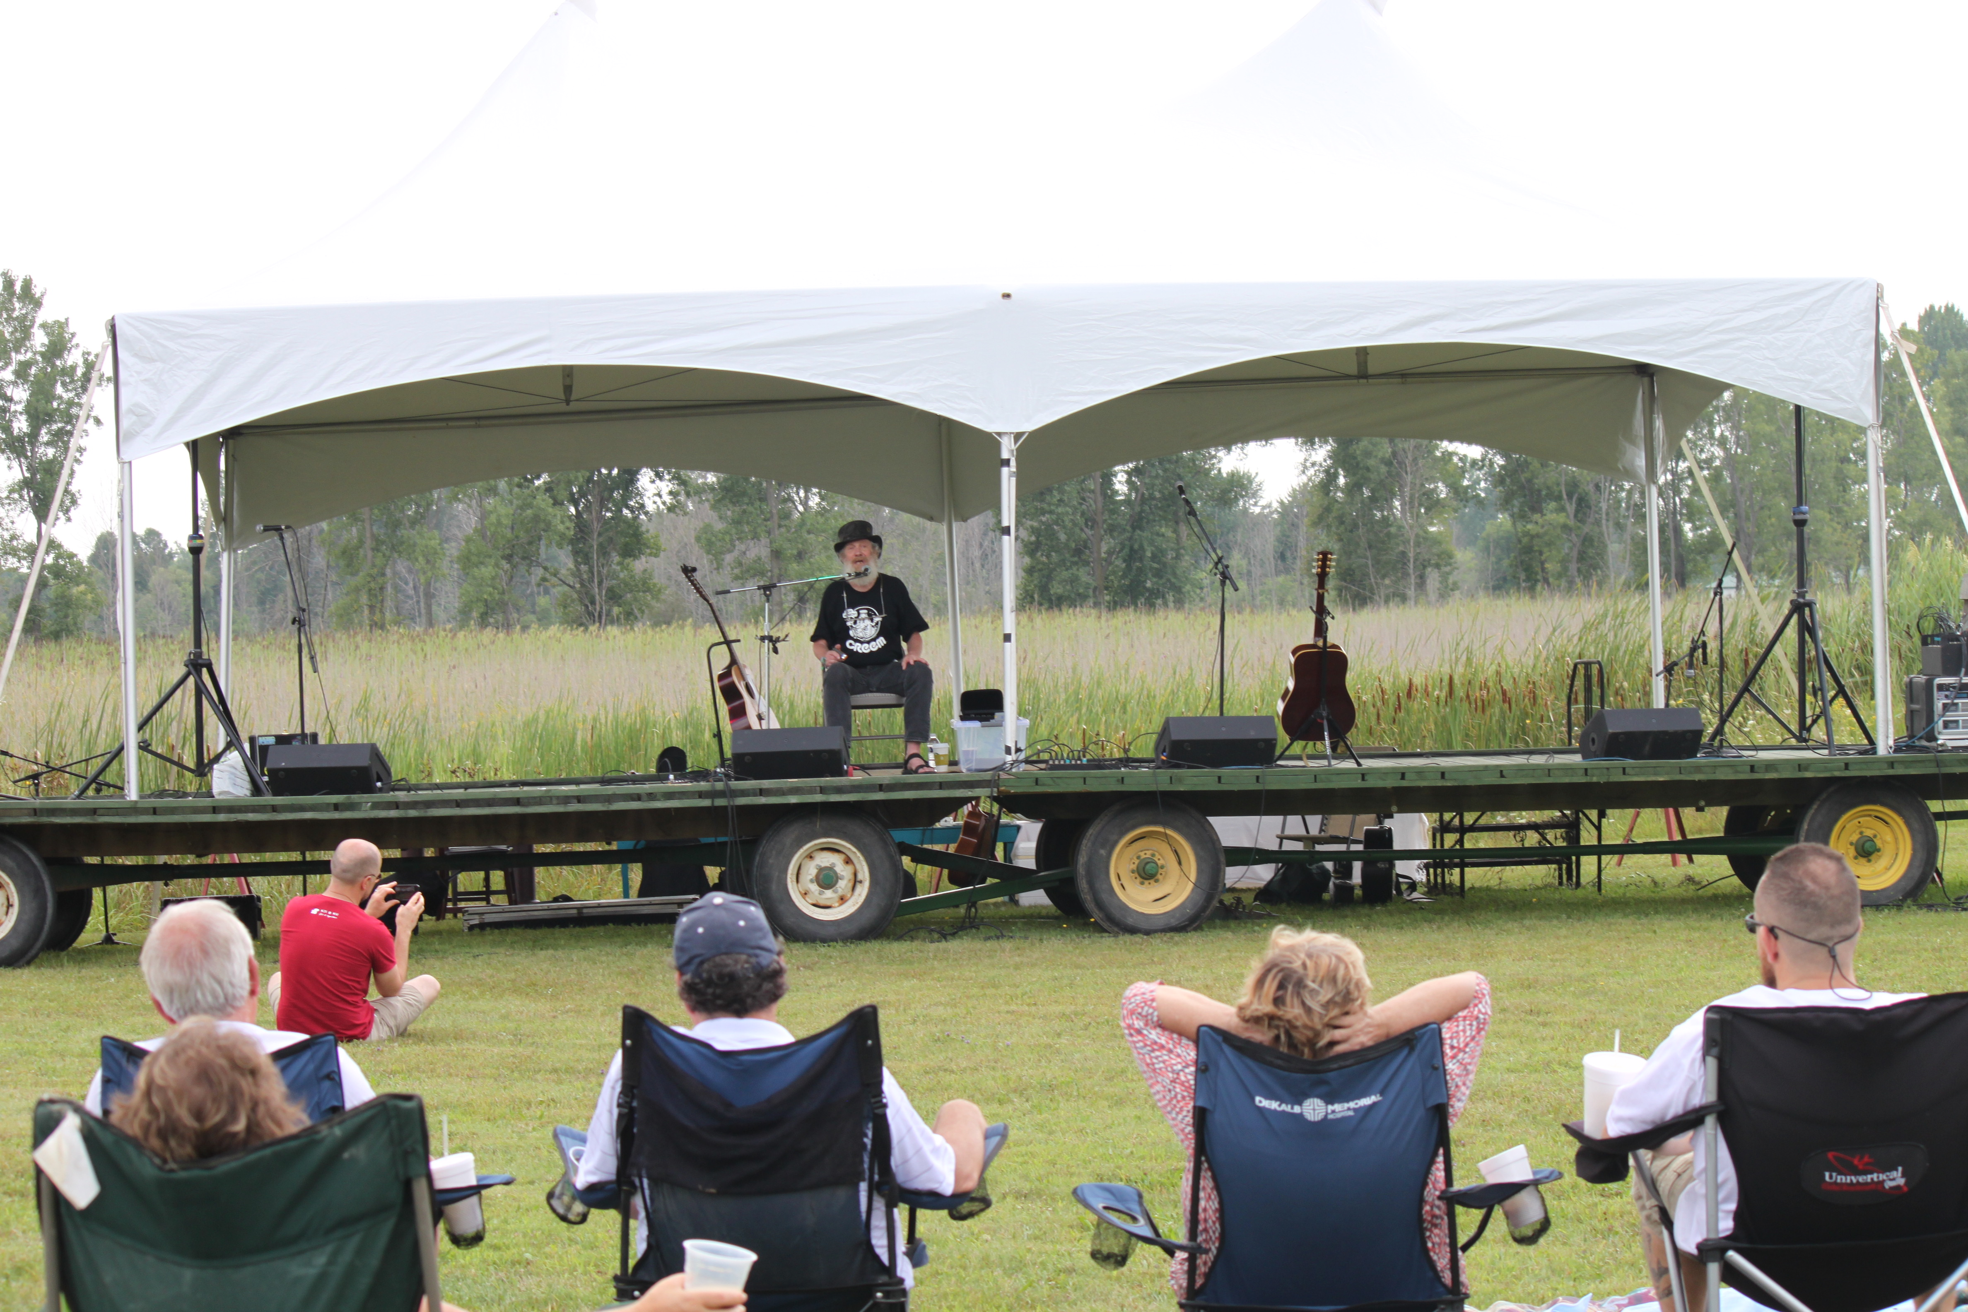
Wide Angle

Slide 5
Medium

Slide 6

Tight

Slide 7

Don’t forget B-Roll
B-roll defined

Slide 8
Other things to remember
Keep camera steady (Tripod can help here)
Be aware of lighting
Be aware of sound (use lav mic when possible)
  If you just use the camera’s mic, odds are you’re going to get too much natural sound bleed.

Slide 9
Grade Your Teacher
This is a video I made for a grad class in multi-media journalism at MSU in the summer of 2011. What works? What doesn’t.

