Slide 1
Juxtaposition:
Opposites can be attractive!

Slide 2
What is Juxtaposition?
Formal Definition: “the fact of two things being seen or placed close together with contrasting effect”
Casual Definition: two items, people, pictures, etc. are used at the same time to showcase how different each of these items really are

Slide 3
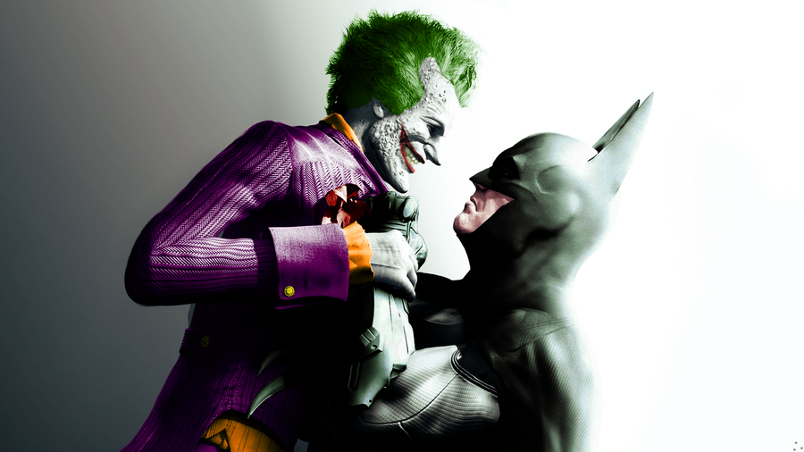
Examples? Examples.
“Placing one really good person and one really bad person in the same scene to show how good the good person is and how bad the bad person is”

Slide 4
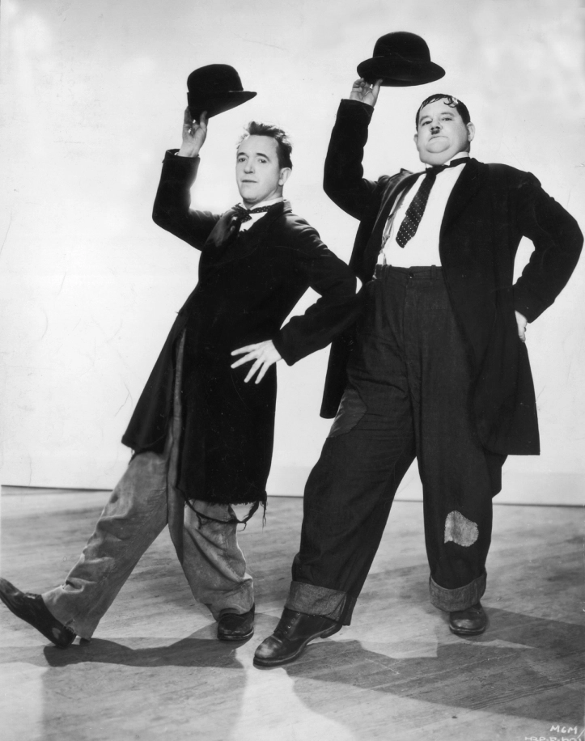

Slide 5
Examples in Literature
Excerpt from Of Mice and Men: (hint hint exam question)
“The first man was small and quick, dark of face, with restless eyes and sharp, strong features. Every part of him was defined: small, strong hands, slender arms, a thin and bony nose. Behind him walked his opposite, a huge man, shapeless of face, with large, pale eyes, with wide, sloping shoulders; and he walked heavily, dragging his feet a little, the way a bear drags his paws. His arms did not swing at his sides, but hung loosely” (Steinbeck 2).

Slide 6
Here’s a great example from a classic film
https://www.youtube.com/watch?vv=-gb0mxcpPOU

Slide 7
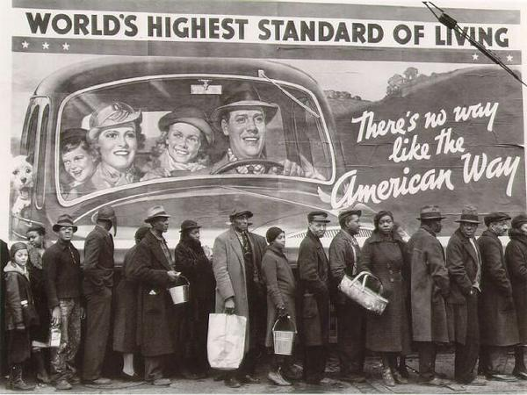

Slide 8
Need more help?
Watch this video:
https://www.youtube.com/watch?v=KrGWS7JtA98

